Slide 1
Image recognition
WDSS Virtual Talk: Opening the Black Box
James Davey

Slide 2
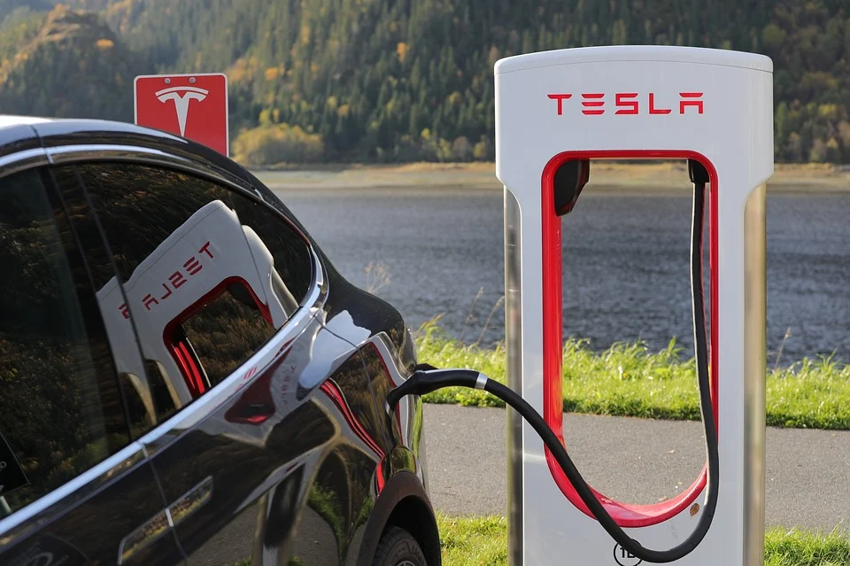

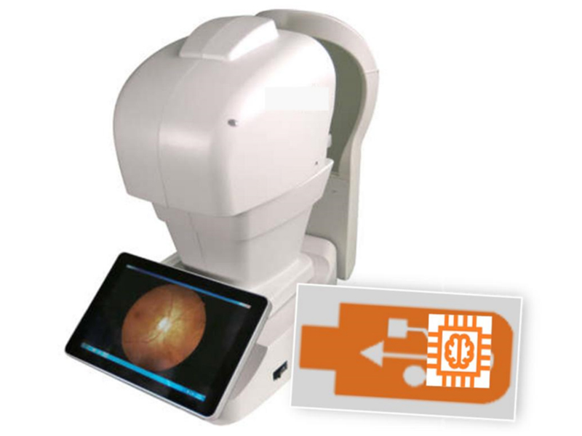
Source1, Source2

Slide 3
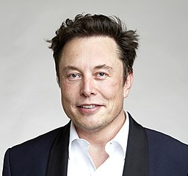
Source

Slide 4
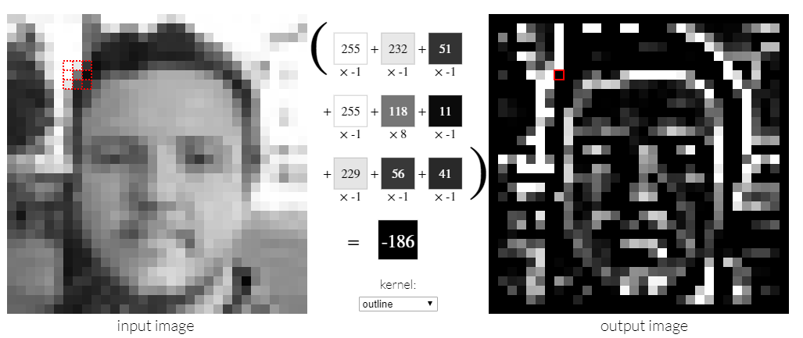
Source

Slide 5

Source

Slide 6


Source
Notes:
Layer 7; layer 14;

Slide 7


Source
Notes:
layer 30; layer 40

Slide 8
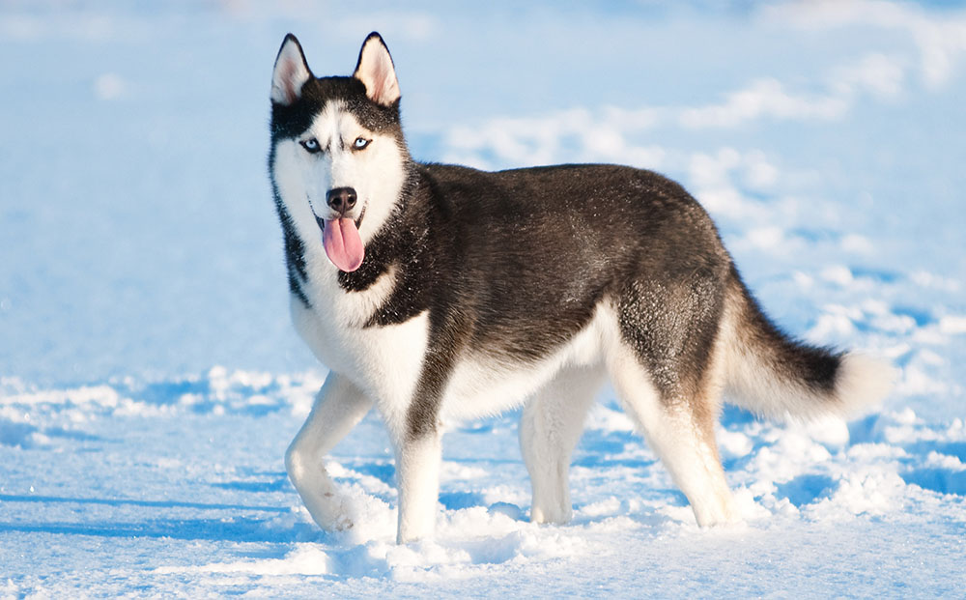
Source

Slide 9
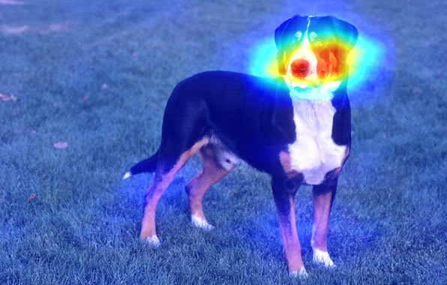
Source

Slide 10
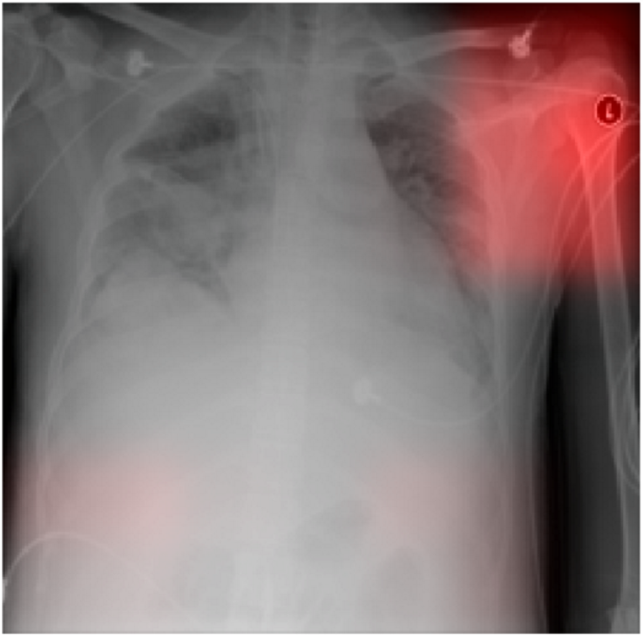
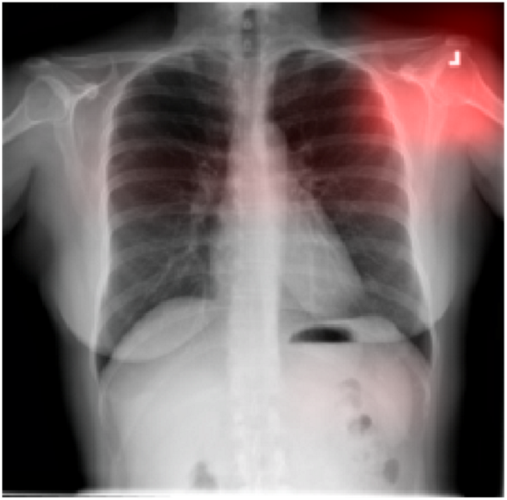
Source

Slide 11
Thanks for listening!

